Slide 1
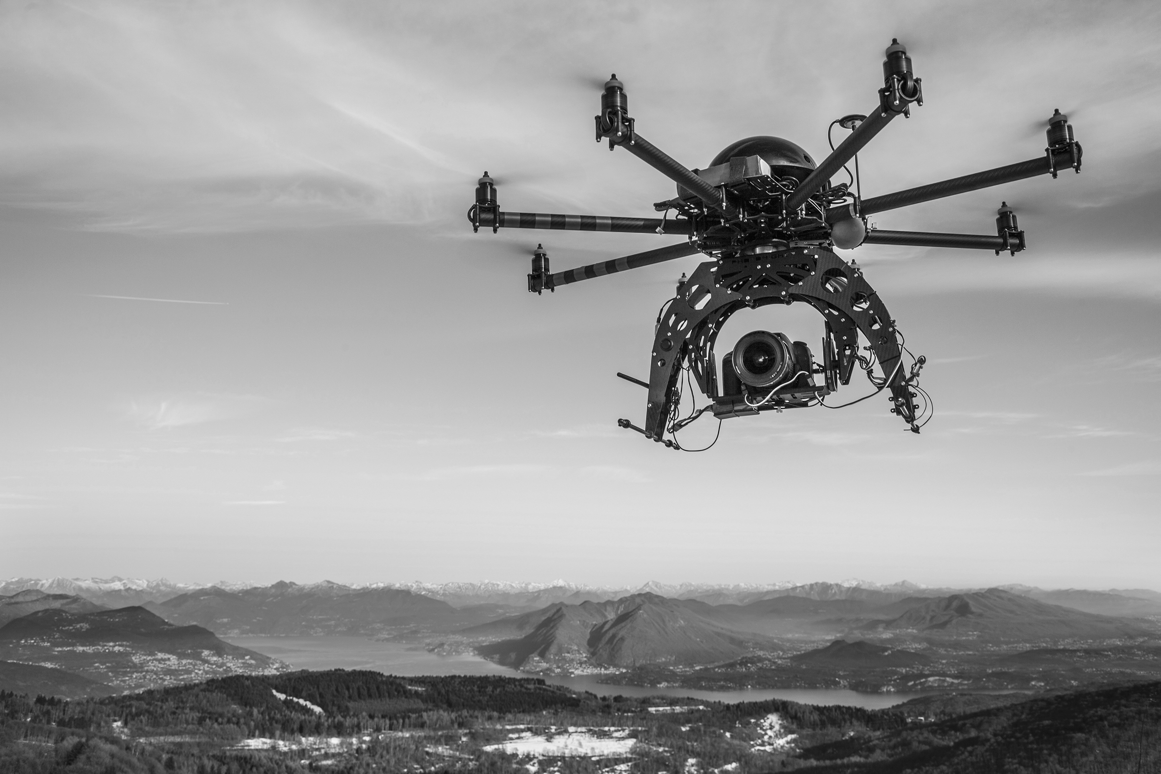



Slide 2
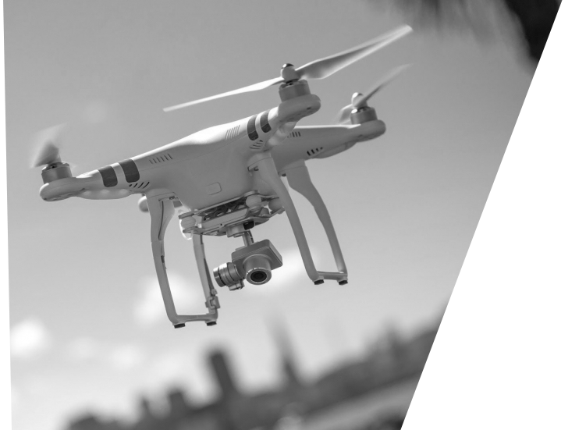





Slide 3
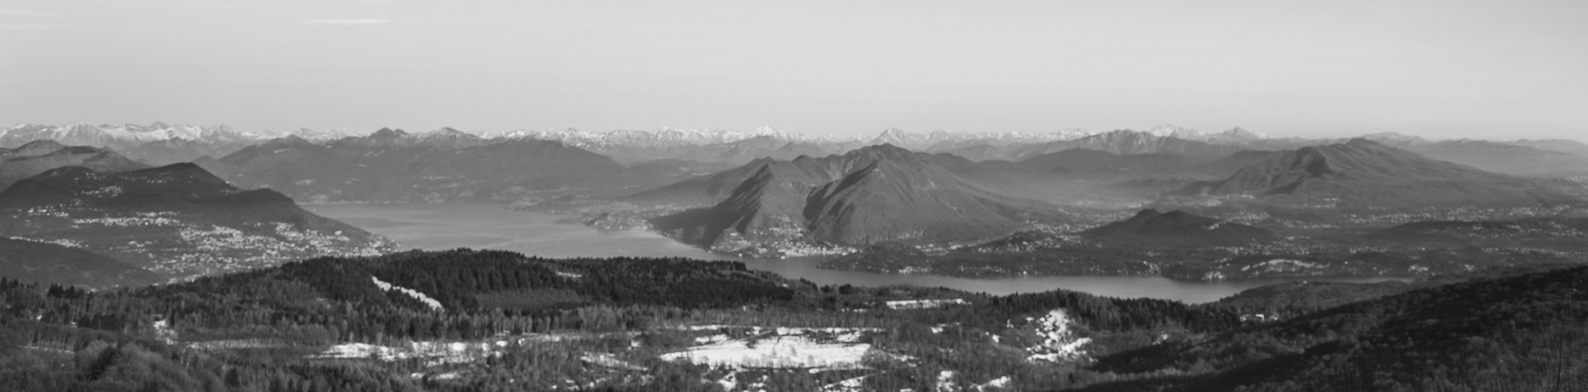

Slide 4
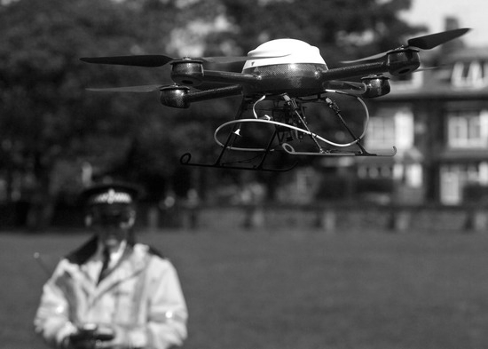
FGDFGDSMKMA
SDANFADJSNFJKANSDJKFNASDJNAKJSDNFK
MDKFMLASKDMFLAKSMDFLKMAS
MDFKASMDFKDSMFNA,

Slide 5
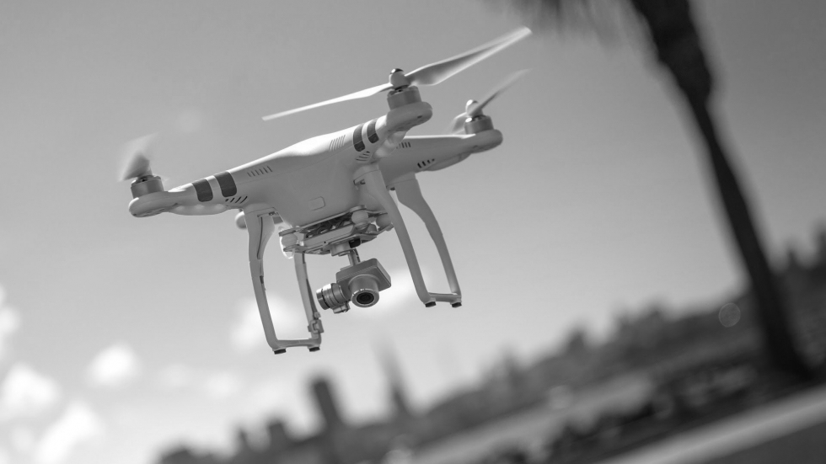
SDFASDFSDFSDFSDF
SNDFN
DFASDFDSAGsdgfasdfgsdafgdafSDFGADFSGDFHSDFHSDFHSDFHSDFHSDFHSDFHS
DFSADFASDFASDFA

Slide 7



